Slide 1
Using Hardware Features for Increased Debugging Transparency 36th IEEE Symposium on Security and Privacy
Fengwei Zhang, Angelos Stavrou, Kun Sun /George Mason University
Kevin Leach / University of Virginia
Haining Wang / University of Delaware

Slide 2
Outline
Motivation
Background
System Architecture
Transparency analysis
Evaluation
Conclusion and future work

Slide 3
Motivation
Malware attacks statistics:
Symantec blocked an average of 247000 attacks per day
McAfee (Intel security) reported 8,000,000 new malware samples(MD) in the first quarter in 2014.
Kaspersky reported malware threats have grown 34% with over 200,000 new threats per day in 2014
Computer systems have vulnerable applications that could be exploited by attackers
Notes:
2015統計的

Slide 4
Traditional Malware Analysis
Analysis Tool
Virtual Machine
Malware
Hypervisor (VMM)
Hardware
Using virtualization technology to create an isolated execution environment for malware debugging
Running malware inside a VM
Running analysis tools outside a VM
Notes:
VMI: 用虛擬化的技術創造獨立的分析空間

Slide 5
Traditional Malware Analysis
Analysis Tool
Virtual Machine
Malware
Hypervisor (VMM)
Hardware
Limitations:
Depending on hypervisors that have a large TCB (Trusted Computing Block)
Incapable of analyzing rootkits with same or higher privilege level (e.g., hypervisor and firmware rootkits)
Unable to analyze armored malware with anti-virtualization or anti-emulation techniques
Notes:
TCB: 做出系統為了達到有效運作跟安全性
hypervisor會佔據比較大範圍的TCB
hypervisor rootkit無法防禦ring 0的攻擊，ring 0 包含root model, unroot mode
higher priviledge 代表針對firmware的攻擊

Slide 6
Bare-metal debugging system - MALT
Virtual Machine
Malware
Hypervisor (VMM)
BIOS (SMM)
Analysis Tool
Hardware
This paper presents a bare-metal debugging system that leverages System Management Mode (SMM) for malware analysis
Using SMM as a hardware isolated execution environment to run analysis tools and be capable of debugging hypervisors.
Moves analysis tools from hypervisor-layer to hardware-layer that achieve a high level of transparency
Notes:
SMM放在比hypervisor低層，放在firmware層級
bare-metal

Slide 7
Outline
Motivation
Background
System Architecture
Transparency analysis
Evaluation
Conclusion and future work

Slide 8
System Management Mode (1/2)
System Management Mode (SMM) is special CPU mode existing in x86 architecture, and it can used as a hardware isolated execution environment.
Original designed for implementing system-wide functions (e.g., power management , system hardware control)
Isolated System Management RAM (SMRAM) that is inaccessible from OS
Only way to enter SMM is to trigger a System Management Interrupt (SMI)
Executing RSM instruction to resume OS (Protected Mode)
Notes:
專屬自己的ram空間，沒人可以存取
RSM=>resume到normal OS

Slide 9
System Management Mode (2/2)
SMM is triggered by asserting the System Management Interrupt (SMI) pin on the CPU.
Approach for Triggering a System Management Interrupt (SMI)
Software-based: Write to an I/O port specified by Southbridge datasheets
mov $0x52f, %dx;
out %ax, (%dx);
Hardware-based: using hardware devices (e.g., Network card, keyboard, hardware timers) to trigger SMI
Notes:
唯一進去到SMM的方法是觸發interrupt
透過port方式
用威盛晶片，也可以用intel的某特殊硬體

Slide 10
The flow of triggering SMI
Protected Mode
System Management Mode
Triggering SMI
Highest privilege
Isolated SMRAM
Interrupts disable
Software
or
Hardware
SMI Handler
SMM Entry
SMM Exit
RSM
Normal OS
Isolated Execution Environment
Notes:
類似VM entry exit，採用interrupt、RSM

Slide 11
Outline
Motivation
Background
System Architecture
Transparency analysis
Evaluation
Conclusion and future work

Slide 12
System Architecture
Traditionally malware debugging uses virtualization or emulation
They will be detected by the existing anti-VM and anti-emulation techniques.
MALT debugs malware on a bare-metal machine and remains transparent in the presence of existing anti-debugging, anti-VM, and anti-emulation techniques.

Slide 13
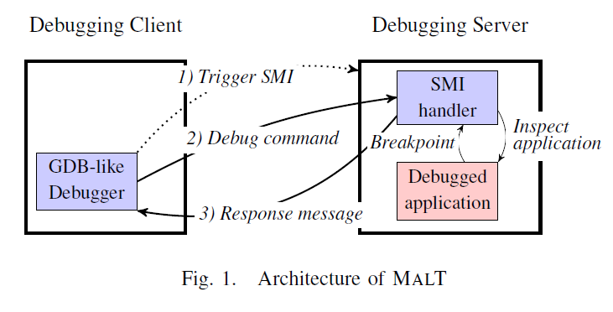
System Architecture
下指令給server

Slide 14
Debugging Client / Server
The debugging client is a small GDB-like debugger which consists of a simple command line application
Provide simple command such as breakpoint and step-by-step execution
The debugging server (target machine) consists of a computer with custom Coreboot-based BIOS(開源)
Change the SMI handler in the Coreboot code to implement a simple debugging server.實作debugging機制
The client uses serial messages to communicate with the server
Use a USB-to-serial cable to connect two machine

Slide 15
Semantic Gap Reconstruction
If MALT perform step-by-step execution, there is a chance that another application is executing when the SMI occurs.
MALT must be able to identify the target application so that it do not interfere with the execution of unrelated applications.
Use circularly linked list of EPROCESS structure to identify target application:
Use the name field in EPROCESS to get the CR3 value of the target application
Compare the CR3 value to identify if current process is the target process.
Notes:
The CPU state saved by SMM only belongs to the thread that was running when the SMI was triggered.
semantic gap: 很多程式都可能可以進到SMM，但是為了要把真正target。呼叫SMM只在乎在乎的
EPROCESS: 雙向鏈結結構

Slide 16
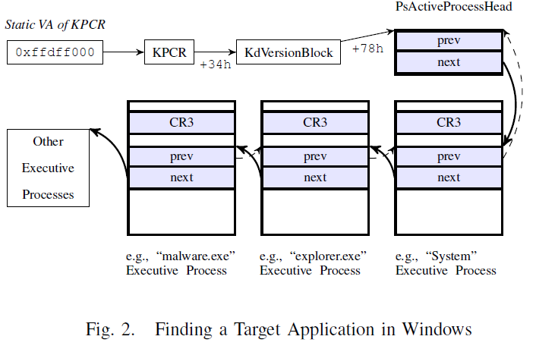
linked list的頭
Kernel Process Control Region
Notes:
KPCR結構

Slide 17
SMI triggering
Using performance counter to trigger a SMI:
This method leverage two components of the CPU:
performance monitoring counter
Local Advanced Programmable Interrupt Controller (LAPIC)
Once a performance counter overflows, an interrupt is generated. The type and destination of this interrupt are determined by the LAPIC, which is responsible for receiving interrupts and forwarding them to the CPU.
Notes:
performance counter: 目前已經被執行了多少個instructions 的計數器
LAPIC: interrupt handler，發出interrupt後由他來控制，performance counter overflow

Slide 18
SMI triggering
Configure the performance Counter Event selection (PerfEvtSel0) register to select counting event.
Set corresponding performance counter (PerfCtr0) register to the maximum value.
If the selected event happens, it overflows the performance counter.
Configure the Local Vector Table Entry (LVTE) in LAPIC to deliver the SMIs when an overflow occurs
Configure the corresponding entry in LVTE
Notes:
retired instructions event: 計算有多少instruction被執行了
把這個event的performance counte設成max，下一行又加一，導致overflow，所以就會進入LAPIC，LAPIC又會把它導向到SMM

Slide 19
Implementation
Use the Retired Instructions Event to single-step the whole system.
To implement step-by-step debugging and breakpoints
Retired Instruction event is a hardware performance event that shows how many instructions were completely executed.
Notes:
一步步偵測跟執行
有多少instruction被執行

Slide 20
Single-stepping
Protected Mode
System Management Mode
Triggering SMI
CPU control flow
SMI Handler
SMM Entry
Ins 1
Ins 2
Ins 3
….
Ins n
SMM Exit
RSM
EIP
Triggering SMI
SMM Entry
SMM Exit
RSM
Normal OS
Isolated Execution Environment
Notes:
triger smi，確認是否為目標，是的話就錄

Slide 21
step-by-step debugging
For each Protected Mode instruction, SMI handler takes the following steps:
Check if the target application is the running thread when the SMI is triggered.
Check command from Debugging client.
Count retired instructions in the performance counter, and set the corresponding performance counter to the maximum value.
Configure the LAPIC so that the performance counter overflow generates a SMI.
Notes:
重新存回max 值，讓他instruction by instruction

Slide 22
Breakpoints
For each Protected Mode instruction, SMI handler takes the following steps:
Check if the target application is the running thread when the SMI is triggered.
Check if current EIP equals a stored breakpoints address.
Count retired instructions in the performance counter, and set the corresponding performance counter to the maximum value.
Configure the LAPIC so that the performance counter overflow generates a SMI.
Notes:
看EIP去看是否與使用者所捨定的位子一致，一致以後

Slide 23
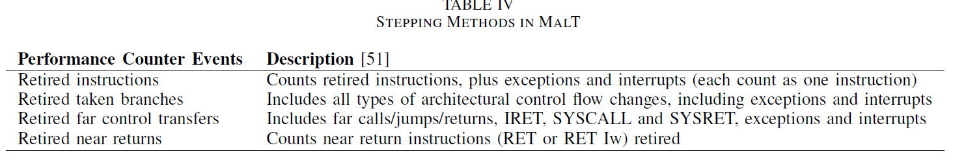
Stepping method in MALT
There are following four stepping method in MALT
Among these four stepping methods, instruction-by-instruction stepping (Retired instructions event) achieves fine-grained tracing, but at the cost of a significant performance overhead.
Using the Retired Near Returns event causes low system overhead, but it only provides coarse-gained tracing.
Notes:
比較嚴謹

Slide 24
Outline
Motivation
Background
System Architecture
Transparency analysis
Evaluation
Conclusion and future work

Slide 25
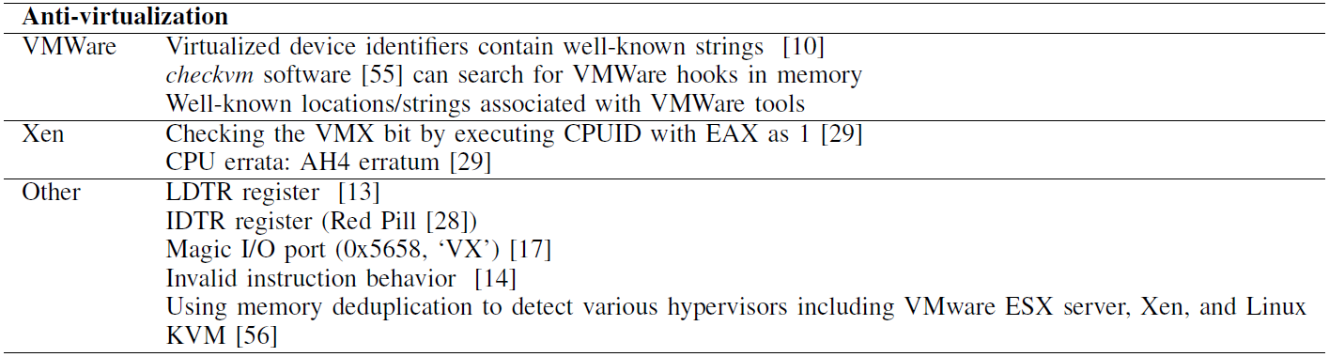
Transparency analysis - Virtualization
Notes:
anti-virtualization: 偵測是否有特殊路徑或是driver，或是掃描特殊memory環境
virtualization 的問題，我們的系統就是會被最下面的

Slide 26
Memory Deduplication
Memory deduplication is usually implemented using a variant of copy-on-write (COW) techniques, for which, writing to a shared page would incur a longer access time than those non-shared.
Notes:
copy on write: 假設A B同時讀寫同一塊區域，若A先指向了那B也就多一條link連過去，還不會拷貝，但若是B也想要對同一塊區塊寫入的時候才會copy過去
side channel attack: 若B也要去寫的時候，那會比A寫的時候會多一個copy的動作，所以如果兩者寫入的時間差過大，就會代表反應過長，代表share

Slide 27
Memory Deduplication
Load a file into memory, write to all the pages, and record write access time (t1).
Load the same file into two memory regions.
Write to these duplicated pages and record their access time (t2)
t2 is clearly larger than t1 due to copy-on-write(COW)
In a virtualized environment, t2 is clearly larger than t1 due to COW. By contrast, in a non-virtualized environment, there should not be any discernible differences between t1 and t2.

Slide 28
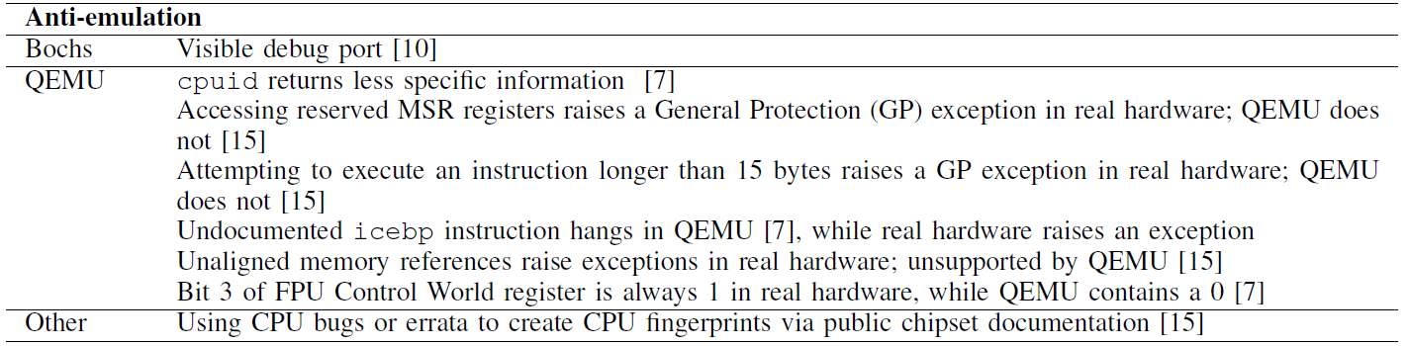
Transparency analysis - Emulation
Notes:
[7] 2012 講較新的
emulation 反偵測: 偵測qemu字串，特定的interrup在qemu不會觸發，但一般情況下會。偵測一些特徵

Slide 29
Transparency analysis - Debugger
Windows API method
IsDebuggerPresent() and CheckRemoteDebuggerPresent() are Windows API methods in the kernel32 library that return values based upon the presence of a debugger.

Slide 30
Transparency analysis - SMM
The following mechanisms make SMM-based system transparent to the application and operating system:
The only way to enter SMM is by means of SMIs
The processor executes SMM code in a separate address space(SMRAM) that is inaccessible from another operating mode(only accessible from SMM mode).
Upon entering SMM, the processor saves the context of the interrupted program or task.
All interrupts normally handled by the operating system are disabled upon entry into SMM
The RSM instruction can be executed only in SMM.
Notes:
進去只有唯一的路，且會保存當時的外界環境狀態，讓他resume可以繼續執行
cpu mode獨立起來的

Slide 31
Side effects
Here are some side effect introduced by MALT and show how to mitigate them.
CPU
Memory & Cache
IO Configurations & BIOS
Timing
To achieve highest level transparency requires MALT to run in instruction by instruction mode.

Slide 32
CPU
performance counter
MALT rely on the performance monitoring register and LAPIC to generate SMIs.
Although these registers are inaccessible from user-level malware, attacker with ring 0 privilege can read and modify them
Relocating the base address of LAPIC register to another physical address by modifying the value in the 24-bit base address field of the IA32_APIC_BASE Model Specific Register (MSR).
To find the LAPIC registers, attackers need to read IA32 APIC BASE MSR first that we can intercept.
RDMSR,RDPMC and WRMSR are the only instructions that ca access the performance counters or MSR.
Run MALT in instruction-by-instruction mode and adjust the return values seen by these instructions before resuming Protected mode.
Notes:
檢查自己有否被監控

Slide 33
Memory & Cache
MALT use an isolated memory region (SMRAM) from normal memory in Protected Mode.
Any access to this memory in other CPU modes will be redirected to VGA memory. (for all x86 platforms)
To avoid cache-based side channel detection, MALT does not flush the cache when entering and exiting SMM.
Notes:
非SMM model想要讀取這一塊記憶體的時候就會去把它redirect(x86)

Slide 34
IO Configuration & BIOS
MALT reroutes a serial interrupt to generate an SMI to initialize a debugging session, and the modified redirection table entry in I/O APIC can be read by malware with ring 0 privilege.
Change the redirection table entry back to its original value to remove this footprint in the first generated SMI handler.
MALT uses a custom BIOS, Coreboot, to program the SMM code. An attacker with ring 0 privilege can check the hash value of the BIOS to detect the presence of our system.
To avoid this fingerprint, we flash the BIOS with the original image before the debugging process using the tool Flashrom.
At that time, the SMI handler, including the MALT code has been loaded into SMRAM and locked.
Notes:
初始化debugging session

Slide 35
Timing
However, MALT is not fully transparent
Malware can detect it based on time delay (Timing attack).
Inner-timing attack:
For configurable timer, adjusting the return value by using time value of SMM-exit minus SMM switching time.
Some of the timer cannot be changed(e.g., RDTSC instruction)
Interrupt the instruction, and adjust the return value of timers in instruction level.
external-timing attack
Malware can send a packets to a remote server to get correct timing information (e.g., NTP service)
Such attacks are difficult to contend with because we cannot always know when a particular packet contains timing information.

Slide 36
Outline
Motivation
Background
System Architecture
Transparency analysis
Evaluation
Conclusion and future work

Slide 37
Testbed specification
Target machine (Debugging server)
Motherboard: ASUS M2V-MX-SE
CPU: 2.2GHz AMD LE-1250
Chipsets: AMD K8 Northbridge + VIA VT8237r Southbridge
BIOS: Coreboot + SeaBIOS
OS: Windows XP SP3 / CentOS 5.5
Debugging client:
A laptop with 2.4 GHz intel core i5-2430M CPU and 6GB RAM
OS: Ubuntu 12.04 LTS

Slide 38
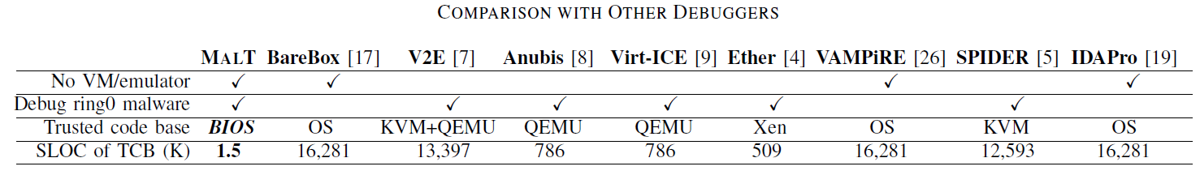
Code size
Using cloc to compute the number of source lines of code (SOLC)
Add 1500 lines of C code
After compiling the Coreboot code, the size of the image was 1 MB

Slide 39
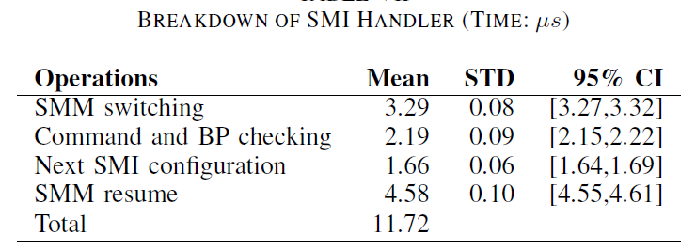
Breakdown of operation

Slide 40
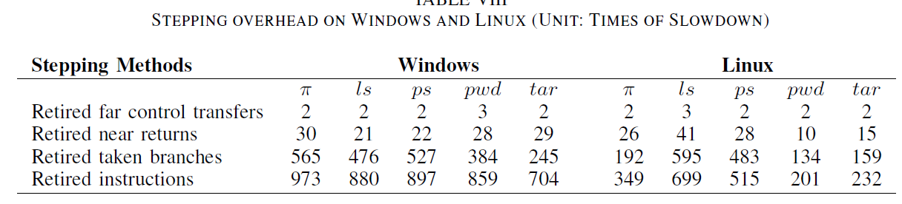
Stepping overhead
Measure the performance overhead of the four stepping method on both Windows and Linux platforms.
Leverage the SuperPI, a single-threaded benchmark that calculate the value of π to a specific number of digit and output the calculation time.

Slide 41
Outline
Motivation
Background
System Architecture
Transparency analysis
Evaluation
Conclusion and future work

Slide 42
Conclusion
MALT does not require the level of trust associated with hypervisors or operating systems. Thus, it is immune to hypervisor attacks and is capable of analyzing and debugging hypervisor-based rootkits and OS kernels.
MALT can remain transparent to armored malware with anti-debugging ,anti- virtualization and anti-emulation.
MALT introduces moderate but manageable overheads on Windows and Linux, which range from 2 to 973 times slowdown, depending on the stepping method.

Slide 43
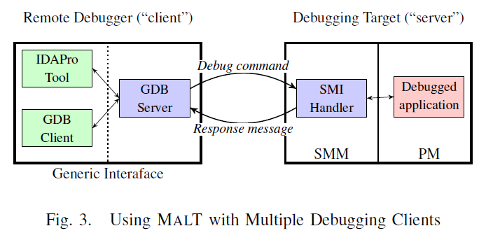
Future Work

